Slide 1
Faculty Research, Teaching, and the Role of the Library
The Ithaka S+R Local Faculty Survey

Slide 2
Idea of the survey
Survey modules:
  Discovery and Access
  Scholarly Communications
  Research Practices
  Role of the Library
  Instructional Practices
  Additional modules on undergraduate and graduate instructional practices

Slide 3
Respondent data
It was a very long survey. Thank you for completing it.
769 Faculty surveyed
  296 clicked
  199 completed (~26%)

Slide 4
Results
Results include:
  Detailed response report
  Data stratifications based on demographics
  National comparative data (coming this summer)
Complete results available at https://libguides.astate.edu/ithaka

Slide 5
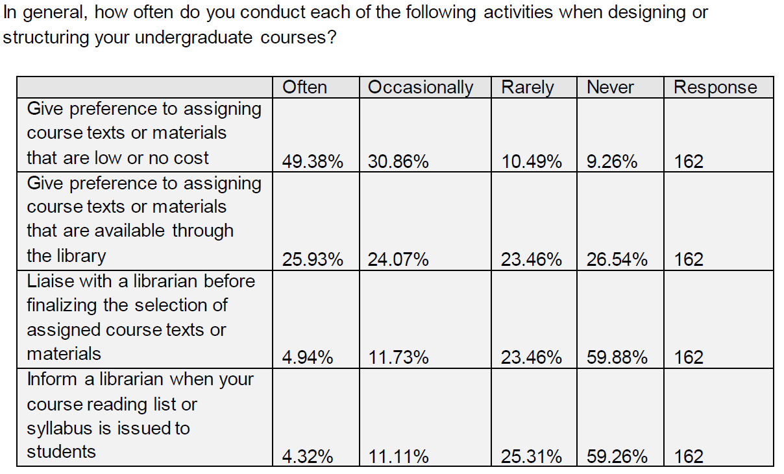
Taking action

Slide 6
Taking action – New Services!
Reading List and Course Text Support
  Determine access to readings and texts
  Help disseminate that information (BlackBoard embed, etc.)
  Work with faculty to purchase ebooks to use in courses
Predatory Journal/Conference Guidance

Slide 7
More to come
Contact me at:
  Robert Robinette, rrobinette@astate.edu
Again, complete survey results available at https://libguides.astate.edu/ithaka

